Slide 1
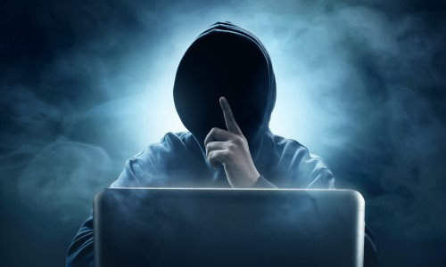
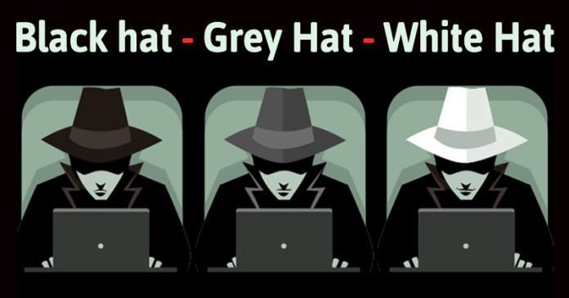
What is a Hacker
Evil?
or Good?

Slide 2
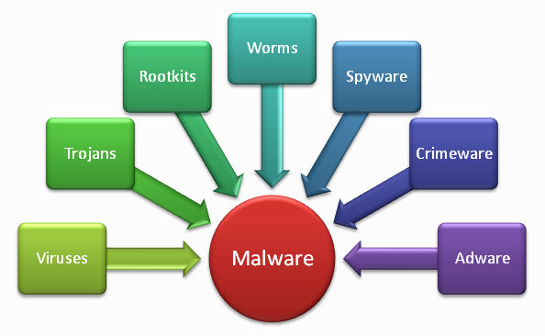
What is a Computer Virus?
PHISH (email, click-bate)
Worm
Trojan
Ransomware

Slide 3
Rise of the Hackers
NOVA Video
https://www.youtube.com/watch?v=-ZdasoAGMQs

Slide 4
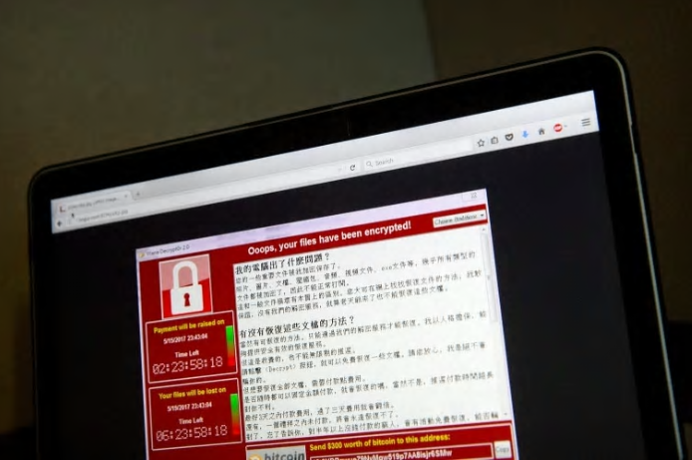
Ransomware Attack (2017)
Oshawa Hospital (East side of Toronto)
Encrypted all patient data files
Made them unreadable and inaccessible
Knocked out all computers at the hospital
Hospital had to restore all computers from backups.
Part of a Global Attack
150 Other Countries Affected
Spread by a Spam Email
Click on the link and your Computer is infected
Your computer then spreads the virus to other computers in your local network.

